Slide 1

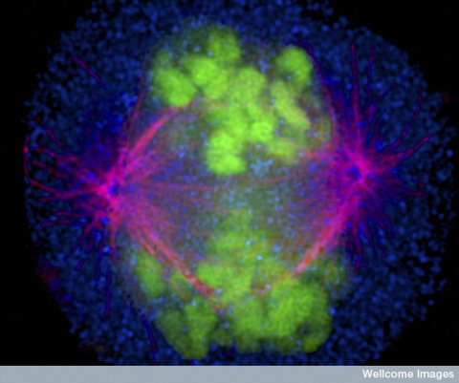

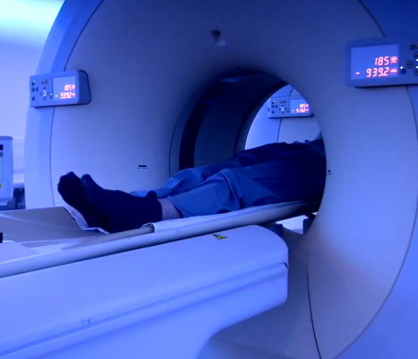



Drilling Down on Molecular Targeted Approaches to Therapy
Professor Peter Schmid, MD PhD FRCP
Lead, Centre for Experimental Cancer Medicine
Barts Cancer Institute, St Bartholomew’s Hospital
Queen Mary University of London

Slide 2
Molecular Targeted Approaches to Therapy in MBC
Key molecular pathways in MBC
ER signaling, PI3K/mTOR, cyclin D/CDK4/6
HER2 and HER3
DNA damage repair
Immune checkpoints
Pathway adaptation over time and therapeutic implications
Mutation analysis and biomarkers to select targeted treatments

Slide 3



ER-Signaling and Anti-oestrogen Therapy
Understanding the Cellular Signaling Network
IGFR
EGFR/
HER2
SOS
RAS
PI3-K
RAF
Akt
MEK
ER
mTOR
P90^{RSK}
MAPK
Ligand-dependent Transcription
ER
ER
Growth Factor
ERE
Target-gene
Estrogen/Tamoxifen
Adapted from Johnston SR. Clin Cancer Res. 2005;11(2 Pt 2):889s-899s.

Slide 4
ER-Signaling and Anti-oestrogen Therapy
Understanding the Cellular Signaling Network
IGFR
EGFR/
HER2
P
P
P
SOS
P
RAS
PI3-K
RAF
P
Akt
MEK
P
ER
mTOR
P90^{RSK}
MAPK
P
P
Proliferation
Cell Survival
Invasion
ER
P
ER
P
P
P
P
Growth Factor
ERE
Target-gene
Estrogen/Tamoxifen
Adapted from Johnston SR. Clin Cancer Res. 2005;11(2 Pt 2):889s-899s.

Slide 5
ER-Signaling and Anti-oestrogen Therapy
Understanding the Cellular Signaling Network
IGFR
EGFR/
HER2
P
P
P
SOS
P
RAS
PI3-K
RAF
P
Akt
MEK
P
ER
mTOR
P90^{RSK}
MAPK
P
P
Ligand-independent transcription
Proliferation
Cell Survival
Invasion
ER
P
ER
P
P
P
P
Growth Factor
ERE
Target-gene
Estrogen/Tamoxifen
Adapted from Johnston SR. Clin Cancer Res. 2005;11(2 Pt 2):889s-899s.

Slide 6
ER-Signaling and Anti-oestrogen Therapy
Understanding the Cellular Signaling Network
IGFR
ER
MMP
ER
EGFR/
HER2
P
P
P
SOS
P
RAS
PI3-K
RAF
P
Akt
MEK
P
ER
mTOR
P90^{RSK}
MAPK
P
P
Ligand-independent transcription
Proliferation
Cell Survival
Invasion
ER
P
ER
P
P
P
P
Growth Factor
ERE
Target-gene
Estrogen/Tamoxifen
Adapted from Johnston SR. Clin Cancer Res. 2005;11(2 Pt 2):889s-899s.

Slide 7
ER-Signaling and Anti-oestrogen Therapy
Understanding the Cellular Signaling Network
IGFR
ER
MMP
ER
EGFR/
HER2
P
P
P
SOS
P
RAS
PI3-K
RAF
P
Akt
MEK
P
ER
mTOR
P90^{RSK}
MAPK
P
P
Ligand-independent transcription
Proliferation
Cell Survival
Invasion
ER
P
ER
P
P
P
P
Growth Factor
ERE
Target-gene
Estrogen/Tamoxifen
Adapted from Johnston SR. Clin Cancer Res. 2005;11(2 Pt 2):889s-899s.

Slide 8
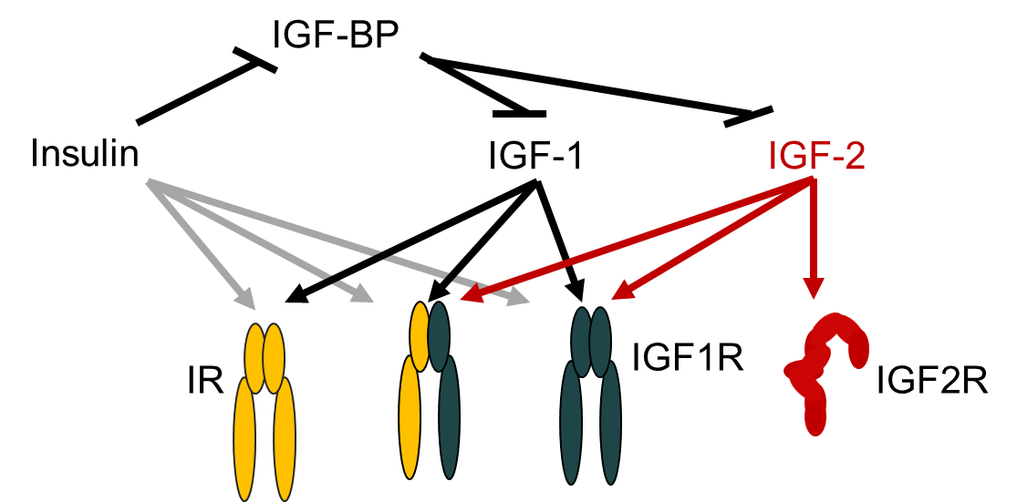
ER-Signaling and Anti-oestrogen Therapy
Understanding the Cellular Signaling Network
Complex biology
8 receptor combinations, 3 ligands, 6 ligand-binding proteins;
Variable expression of heterodimers
IGFR
ER
MMP
ER
EGFR/
HER2
P
P
P
SOS
P
RAS
PI3-K
RAF
P
Akt
MEK
P
ER
mTOR
P90^{RSK}
MAPK
P
P
Ligand-independent transcription
Proliferation
Cell Survival
Invasion
ER
P
ER
P
P
P
P
Growth Factor
ERE
Target-gene
Estrogen/Tamoxifen
Adapted from Johnston SR. Clin Cancer Res. 2005;11(2 Pt 2):889s-899s.

Slide 9
ER-Signaling and Anti-oestrogen Therapy
Understanding the Cellular Signaling Network
IGFR
ER
MMP
ER
EGFR/
HER2
P
P
P
SOS
P
RAS
PI3-K
RAF
P
Akt
MEK
P
P90^{RSK}
MAPK
P
P
Ligand-independent Transcription
Proliferation
Cell Survival
Invasion
Ligand-dependent Transcription
ER
ER
Growth Factor
ERE
Target-Gene
Estrogen/Tamoxifen
Adapted from Johnston SR. Clin Cancer Res. 2005;11(2 Pt 2):889s-899s.

Slide 10
ER-Signaling and Anti-oestrogen Therapy
Understanding the Cellular Signaling Network
Comp. up-regulation of other receptors
? Effect if constitutive downstream activation
IGFR
ER
MMP
ER
EGFR/
HER2
P
P
P
SOS
P
RAS
PI3-K
RAF
P
Akt
MEK
P
P90^{RSK}
MAPK
P
P
Ligand-independent Transcription
Proliferation
Cell Survival
Invasion
Ligand-dependent Transcription
ER
ER
Growth Factor
ERE
Target-Gene
Estrogen/Tamoxifen
Adapted from Johnston SR. Clin Cancer Res. 2005;11(2 Pt 2):889s-899s.

Slide 11
ER-Signaling and Anti-oestrogen Therapy
Understanding the Cellular Signaling Network
IGFR
ER
MMP
ER
EGFR/
HER2
P
P
Point of convergence
Blocks PI3K/mTOR pathway activation
P
SOS
P
RAS
PI3-K
RAF
P
Akt
MEK
P
P90^{RSK}
MAPK
P
P
Ligand-independent Transcription
Proliferation
Cell Survival
Invasion
Ligand-dependent Transcription
ER
ER
Growth Factor
ERE
Target-Gene
Estrogen/Tamoxifen
Adapted from Johnston SR. Clin Cancer Res. 2005;11(2 Pt 2):889s-899s.

Slide 12
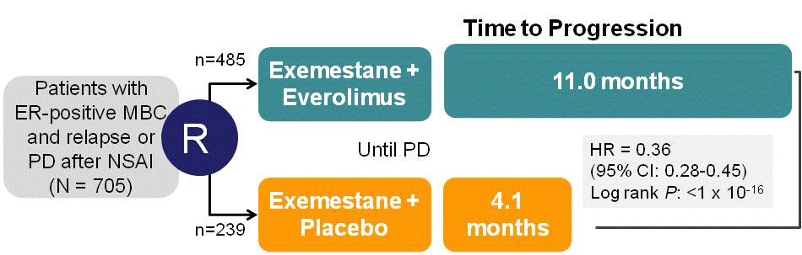
ER-Signaling and Anti-oestrogen Therapy
Understanding the Cellular Signaling Network
IGFR
ER
MMP
ER
EGFR/
HER2
P
P
Point of convergence
Blocks PI3K/mTOR pathway activation
P
SOS
P
RAS
PI3-K
RAF
BOLERO2 Trial
P
Akt
MEK
P
ER
mTOR
P90^{RSK}
MAPK
P
P
Patients with ER-positive MBC and relapse or PD after NSAI
(N = 724)
6.9 months
R
Ligand-independent Transcription
HR = 0.43
(95% CI: 0.35-0.54)
Log rank P<.001
Proliferation
Cell Survival
Invasion
Ligand-dependent Transcription
ER
P
ER
P
P
2.8 months
P
P
Growth Factor
ERE
Target-Gene
Estrogen/Tamoxifen
Adapted from Johnston SR. Clin Cancer Res. 2005;11(2 Pt 2):889s-899s.

Slide 13
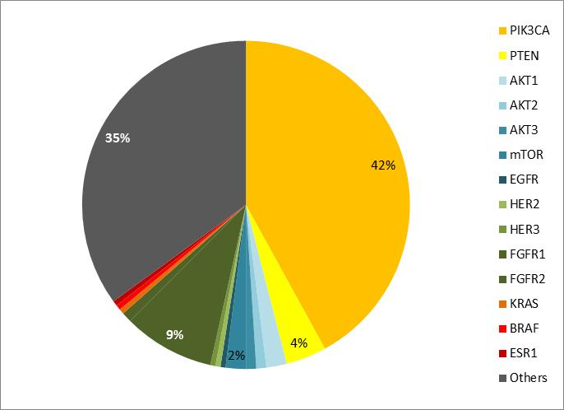
Genetic Aberrations in Signaling Pathways in Luminal Tumors Target-Focused Classification
TGCA, database (www.cbioportal.org)

Slide 14
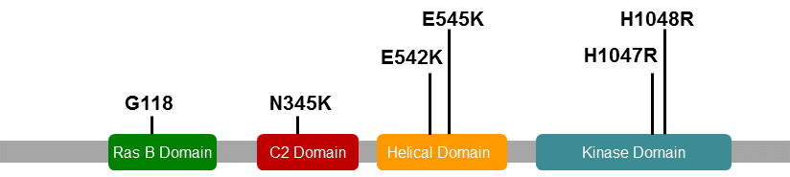
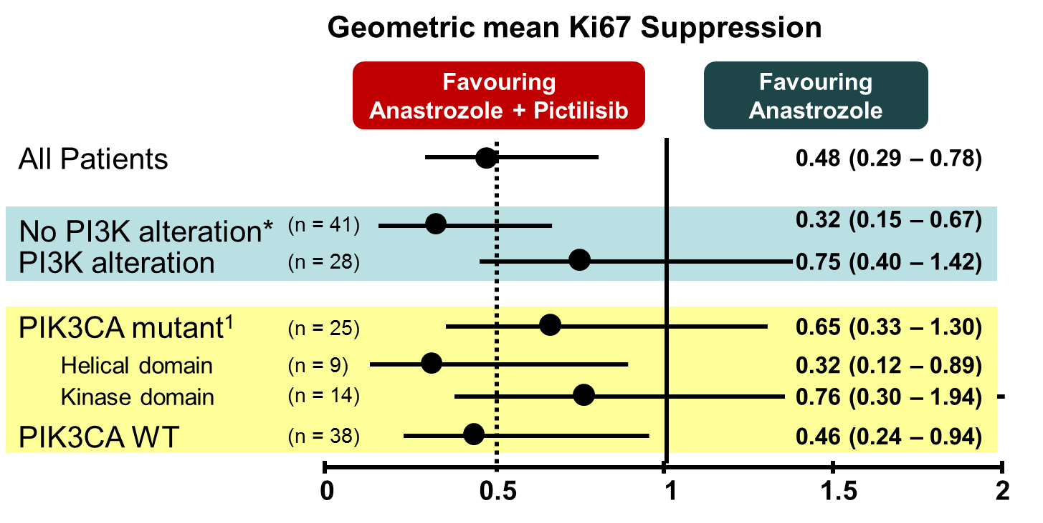
Genetic Aberrations in Signaling Pathways in Luminal Tumors Target-Focused Classification
PIK3CA Mutations in Breast cancer
Activating PI3KCa mutations occur in 30-40% of ER+ BC
Are PIK3CA the best biomarker for benefit from PI3K/mTOR inhibition?
Schmid P, et al, Presented at: SABCS 2014.
TGCA, database (www.cbioportal.org)

Slide 15
Genetic Aberrations in Signaling Pathways in Luminal Tumors Target-Focused Classification
PIK3CA Mutations in Breast cancer
Schmid P, et al, Presented at: SABCS 2014.
TGCA, database (www.cbioportal.org)

Slide 16
Genetic Aberrations in Signaling Pathways in Luminal Tumors Target-Focused Classification
Isolated genetic analysis often fails to define functional relevance and cellular dependence of aberrant target
PIK3CA Mutations in Breast cancer
Schmid P, et al, Presented at: SABCS 2014.
TGCA, database (www.cbioportal.org)

Slide 17
Understanding Cellular Signaling Networks: PI3K/mTOR Pathway Challenges Around Identifying Biomarkers
Target
Other network regulators
+
-
Downstream target
Multiple targets
+
-
Activation signature

Slide 18
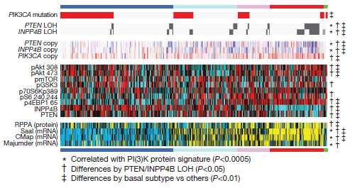
Understanding Cellular Signaling Networks: PI3K/mTOR Pathway Challenges Around Identifying Biomarkers
Luminal A
Luminal B
HER2
Basal
Cancer Genome Atlas Network. Nature. 2012;490(7418):61-70.

Slide 19
Understanding Cellular Signaling Networks: PI3K/mTOR Pathway Challenges Around Identifying Biomarkers
Luminal A
Luminal B
HER2
Basal
Higher activity in Luminal B subtype
Cancer Genome Atlas Network. Nature. 2012;490(7418):61-70.

Slide 20
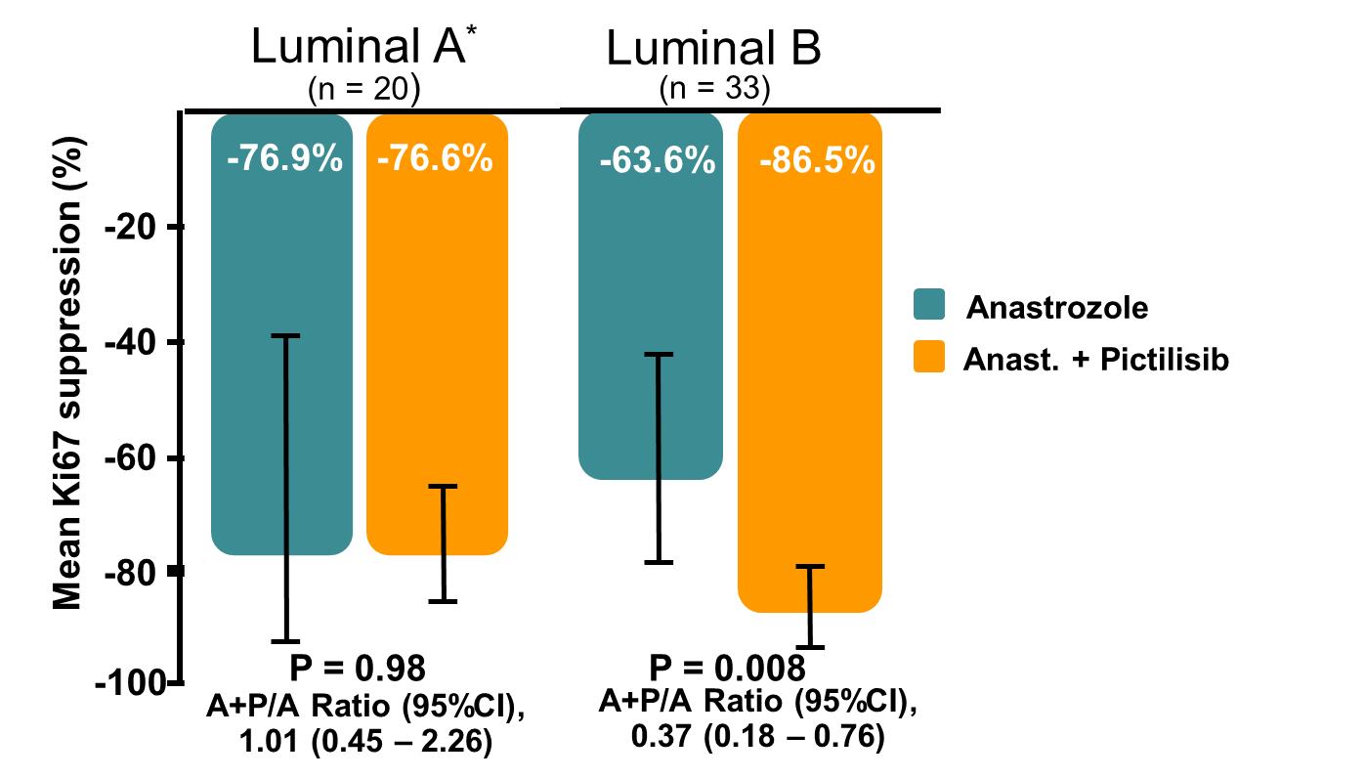
Understanding Cellular Signaling Networks: PI3K/mTOR Pathway Challenges Around Identifying Biomarkers
Luminal A
Luminal B
HER2
Basal
Geometric mean Ki67 Suppression by Subtype
Target
Other network regulators
+
-
Downstream Target
Multiple targets
+
-
Higher activity in Luminal B subtype
Schmid P et al, SABCS 2014
Highest activity in basal subtype
Activation signature
Cancer Genome Atlas Network. Nature. 2012;490(7418):61-70.

Slide 21
Understanding Cellular Signaling Networks: PI3K/mTOR Pathway Challenges Around Identifying Biomarkers
Luminal A
Luminal B
HER2
Basal
Highest activity in basal subtype
Cancer Genome Atlas Network. Nature. 2012;490(7418):61-70.

Slide 22
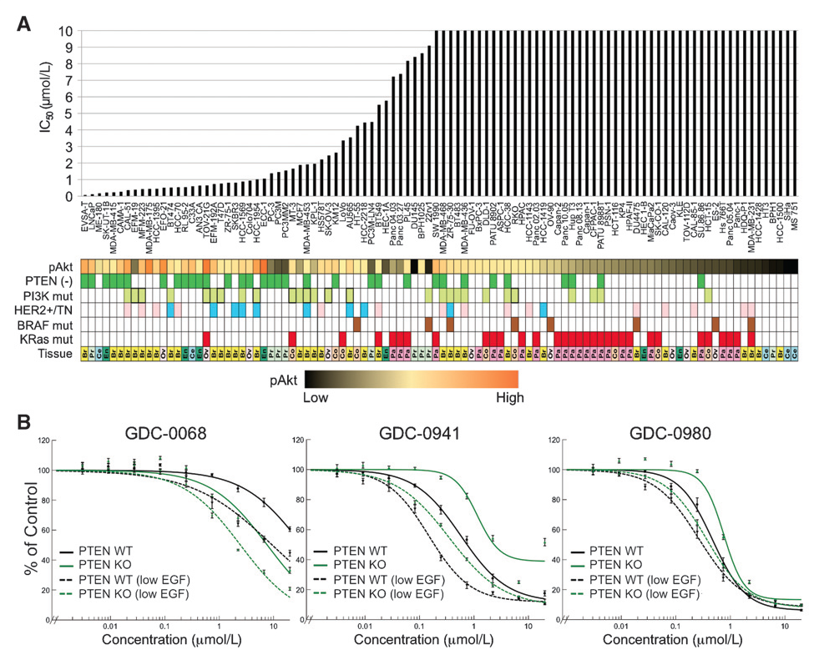
Understanding Cellular Signaling Networks: PI3K/mTOR Pathway Challenges Around Identifying Biomarkers
Luminal A
Luminal B
HER2
Basal
AKT-Inhibitor
Pan PI3K-Inhibitor
Geometric mean Ki67 Suppression by Subtype
Target
Other network regulators
+
-
Downstream Target
PI3K/mTOR-Inhibitor
Cancer with PTEN loss may be particularly sensitive to AKT inhibitors
Multiple targets
+
-
Higher activity in Luminal B subtype
Schmid P et al, SABCS 2014
Highest activity in basal subtype
Activation signature
Lin J, et al. Clin Cancer Res. 2013;19(7):1760-1772.
Cancer Genome Atlas Network. Nature. 2012;490(7418):61-70.

Slide 23
Targeting Cell Cycle Control (CDK4/6)
RAS
PI3-K
P
P
PTEN
M
AKT
mTOR
G₂
G₁
S
E2F
p70S6K
p16^{INK4A}
CDK4/6
P
Rb
Cyclin D1
Rb

Slide 24
Targeting Cell Cycle Control (CDK4/6)
Targeting CDK4/6:
Intact Rb required for therapeutic approach
CyclinD-CDK4/6 axis frequently dysregulated in ER+ BC with intact Rb (LumA 23%, LumB 49%)
Loss of Rb common in TNBC
RAS
PI3-K
P
P
PTEN
M
AKT
mTOR
G₂
G₁
S
E2F
p70S6K
p16^{INK4A}
CDK4/6
P
Rb
Cyclin D1
Rb

Slide 25
Targeting Cell Cycle Control (CDK4/6)
Targeting CDK4/6:
Intact Rb required for therapeutic approach
CyclinD-CDK4/6 axis frequently dysregulated in ER+ BC with intact Rb (LumA 23%, LumB 49%)
Loss of Rb common in TNBC
RAS
PI3-K
P
P
PTEN
M
AKT
Early studies suggest substantial benefit in ER+ disease
Cyclin D-CDK4/6 aberrations are not predictive of response
G₂
G₁
mTOR
S
E2F
p70S6K
p16^{INK4A}
CDK4/6
P
Rb
Cyclin D1
Rb

Slide 26
Targeting HER2+ Disease
1
2
3
4
Notes:
Schematic representation of domains, conformations, and sites of interaction in HER2 and HER3. (a) Domain structure of monomeric HER2, indicating ECDs I to IV with the primary and secondary dimerization loop in the fifth and sixth module of domain II, a single transmembrane span, the cytoplasmic juxtamembrane segment (* indicates the site of PKC-mediated threonine phosphorylation), the amino- and carboxyl-terminal lobe of the kinase domain, and the carboxyl-terminal tail carrying most adapter binding sites. The sites targeted by Herceptin (Herc.), calmodulin (CaM), and Hsp90 are indicated with arrows. (b) Model of HER2-HER3 heterodimer with bound ligand. NRG indicates the EGF-like domain of neuregulin, bound between domains I and III, and Ig indicates the location of the immunoglobulin-like amino-terminal domain of neuregulins. The receptor dimer is stabilized by reciprocal interactions between domains II of both receptors. The physical separation of domains IV in the diagram does not necessarily indicate physical distance but is meant to emphasize that based on experimental data, and in contrast to transmembrane span packing, domain IV interactions do not contribute significantly to dimer stabilization. The exact nature of interactions by both components (boxed with dashed lines) is not clear at this point. The indicated interactions of the cytoplasmic kinase domains summarize the recently proposed mode of allosteric activation based on EGFR structures [38]. (c) HER3 in the closed/locked conformation, stabilized by an intramolecular tether involving the primary dimerization loop in domain II and its structural equivalent in domain IV.

Slide 27
Targeting HER2+ Disease
1
2
3
4
Notes:
Schematic representation of domains, conformations, and sites of interaction in HER2 and HER3. (a) Domain structure of monomeric HER2, indicating ECDs I to IV with the primary and secondary dimerization loop in the fifth and sixth module of domain II, a single transmembrane span, the cytoplasmic juxtamembrane segment (* indicates the site of PKC-mediated threonine phosphorylation), the amino- and carboxyl-terminal lobe of the kinase domain, and the carboxyl-terminal tail carrying most adapter binding sites. The sites targeted by Herceptin (Herc.), calmodulin (CaM), and Hsp90 are indicated with arrows. (b) Model of HER2-HER3 heterodimer with bound ligand. NRG indicates the EGF-like domain of neuregulin, bound between domains I and III, and Ig indicates the location of the immunoglobulin-like amino-terminal domain of neuregulins. The receptor dimer is stabilized by reciprocal interactions between domains II of both receptors. The physical separation of domains IV in the diagram does not necessarily indicate physical distance but is meant to emphasize that based on experimental data, and in contrast to transmembrane span packing, domain IV interactions do not contribute significantly to dimer stabilization. The exact nature of interactions by both components (boxed with dashed lines) is not clear at this point. The indicated interactions of the cytoplasmic kinase domains summarize the recently proposed mode of allosteric activation based on EGFR structures [38]. (c) HER3 in the closed/locked conformation, stabilized by an intramolecular tether involving the primary dimerization loop in domain II and its structural equivalent in domain IV.

Slide 28
Targeting HER2+ Disease
1
2
3
4
Notes:
Schematic representation of domains, conformations, and sites of interaction in HER2 and HER3. (a) Domain structure of monomeric HER2, indicating ECDs I to IV with the primary and secondary dimerization loop in the fifth and sixth module of domain II, a single transmembrane span, the cytoplasmic juxtamembrane segment (* indicates the site of PKC-mediated threonine phosphorylation), the amino- and carboxyl-terminal lobe of the kinase domain, and the carboxyl-terminal tail carrying most adapter binding sites. The sites targeted by Herceptin (Herc.), calmodulin (CaM), and Hsp90 are indicated with arrows. (b) Model of HER2-HER3 heterodimer with bound ligand. NRG indicates the EGF-like domain of neuregulin, bound between domains I and III, and Ig indicates the location of the immunoglobulin-like amino-terminal domain of neuregulins. The receptor dimer is stabilized by reciprocal interactions between domains II of both receptors. The physical separation of domains IV in the diagram does not necessarily indicate physical distance but is meant to emphasize that based on experimental data, and in contrast to transmembrane span packing, domain IV interactions do not contribute significantly to dimer stabilization. The exact nature of interactions by both components (boxed with dashed lines) is not clear at this point. The indicated interactions of the cytoplasmic kinase domains summarize the recently proposed mode of allosteric activation based on EGFR structures [38]. (c) HER3 in the closed/locked conformation, stabilized by an intramolecular tether involving the primary dimerization loop in domain II and its structural equivalent in domain IV.

Slide 29
Targeting HER2+ Disease
1
2
3
4
+
+
+
+
+
+
Notes:
Schematic representation of domains, conformations, and sites of interaction in HER2 and HER3. (a) Domain structure of monomeric HER2, indicating ECDs I to IV with the primary and secondary dimerization loop in the fifth and sixth module of domain II, a single transmembrane span, the cytoplasmic juxtamembrane segment (* indicates the site of PKC-mediated threonine phosphorylation), the amino- and carboxyl-terminal lobe of the kinase domain, and the carboxyl-terminal tail carrying most adapter binding sites. The sites targeted by Herceptin (Herc.), calmodulin (CaM), and Hsp90 are indicated with arrows. (b) Model of HER2-HER3 heterodimer with bound ligand. NRG indicates the EGF-like domain of neuregulin, bound between domains I and III, and Ig indicates the location of the immunoglobulin-like amino-terminal domain of neuregulins. The receptor dimer is stabilized by reciprocal interactions between domains II of both receptors. The physical separation of domains IV in the diagram does not necessarily indicate physical distance but is meant to emphasize that based on experimental data, and in contrast to transmembrane span packing, domain IV interactions do not contribute significantly to dimer stabilization. The exact nature of interactions by both components (boxed with dashed lines) is not clear at this point. The indicated interactions of the cytoplasmic kinase domains summarize the recently proposed mode of allosteric activation based on EGFR structures [38]. (c) HER3 in the closed/locked conformation, stabilized by an intramolecular tether involving the primary dimerization loop in domain II and its structural equivalent in domain IV.

Slide 30
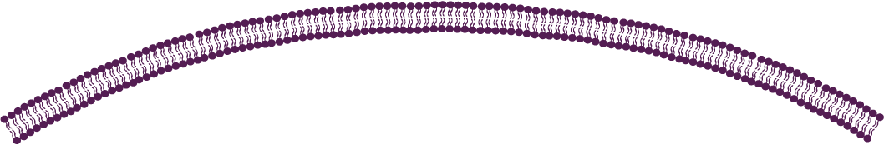
Targeting HER2+ Disease Intracellular Signaling Network
RAS
Sos
Grb2
Shc
P
P
PI3K
P
AKT
P
Raf
PTEN
GSK3b
NFkB
mTOR
CyclinD1
BAD
MEK
p27
MAPK
Apoptosis
Cell cycle control
Survival
Angiogenesis
Proliferation
Notes:
Schematic representation of domains, conformations, and sites of interaction in HER2 and HER3. (a) Domain structure of monomeric HER2, indicating ECDs I to IV with the primary and secondary dimerization loop in the fifth and sixth module of domain II, a single transmembrane span, the cytoplasmic juxtamembrane segment (* indicates the site of PKC-mediated threonine phosphorylation), the amino- and carboxyl-terminal lobe of the kinase domain, and the carboxyl-terminal tail carrying most adapter binding sites. The sites targeted by Herceptin (Herc.), calmodulin (CaM), and Hsp90 are indicated with arrows. (b) Model of HER2-HER3 heterodimer with bound ligand. NRG indicates the EGF-like domain of neuregulin, bound between domains I and III, and Ig indicates the location of the immunoglobulin-like amino-terminal domain of neuregulins. The receptor dimer is stabilized by reciprocal interactions between domains II of both receptors. The physical separation of domains IV in the diagram does not necessarily indicate physical distance but is meant to emphasize that based on experimental data, and in contrast to transmembrane span packing, domain IV interactions do not contribute significantly to dimer stabilization. The exact nature of interactions by both components (boxed with dashed lines) is not clear at this point. The indicated interactions of the cytoplasmic kinase domains summarize the recently proposed mode of allosteric activation based on EGFR structures [38]. (c) HER3 in the closed/locked conformation, stabilized by an intramolecular tether involving the primary dimerization loop in domain II and its structural equivalent in domain IV.

Slide 31
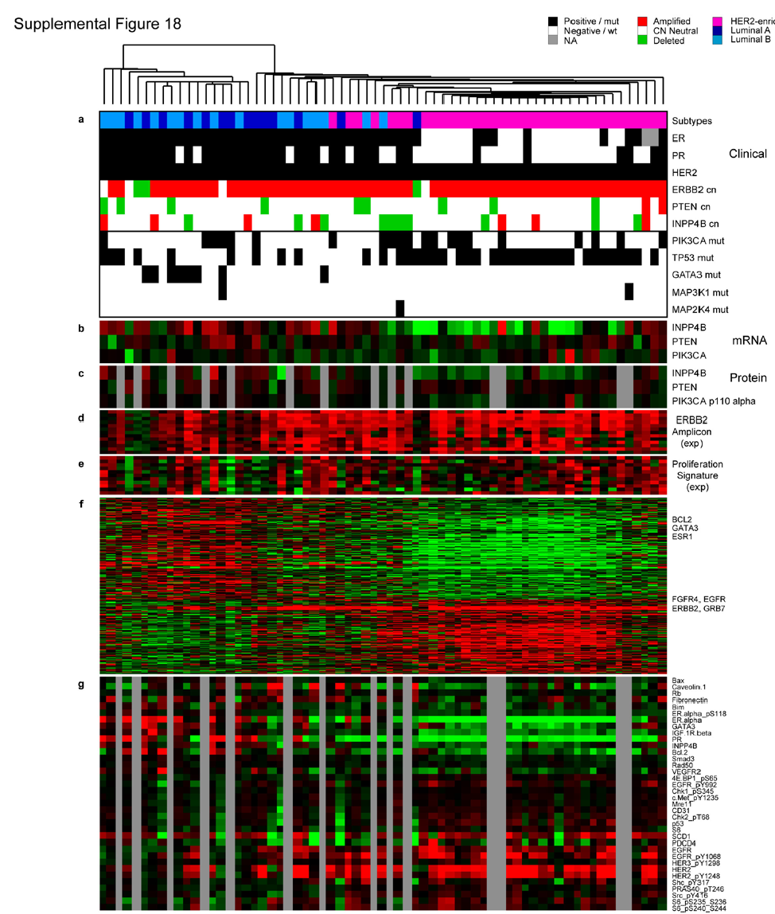
Targeting HER2+ Disease Luminal vs HER2 Subtype & Potential Co-Targets
Cancer Genome Atlas Network. Nature. 2012;490(7418):61-70.

Slide 32
Targeting HER2+ Disease Luminal vs HER2 Subtype & Potential Co-Targets
HER2+/Luminal:
Strong signal for luminal cluster GATA3, BCL2, ESR1
Combination with endocrine therapy?
HER2+/HER2E :
Strong signal for EGFR, FGFR4, HER2 amplicon, pS6;
Amplification of CDK4, cyclin D1, EGFR, FGFRs
GATA3, ESR1, BCL2
EGFR, FGFR, HER2
Combination with EGFR-TKI?
HER3
Cancer Genome Atlas Network. Nature. 2012;490(7418):61-70.

Slide 33
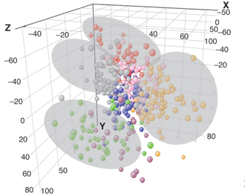
Triple Negative Cancer: Potential Treatment Targets? Heterogeneity Requires Different Strategies
Biological Clusters
Lehmann BD, et al. J Clin Invest. 2011;121(7):2750-2767.

Slide 34
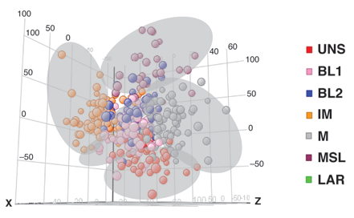
Triple Negative Cancer: Potential Treatment Targets? Heterogeneity Requires Different Strategies
Biological Clusters
Lehmann BD, et al. J Clin Invest. 2011;121(7):2750-2767.

Slide 35
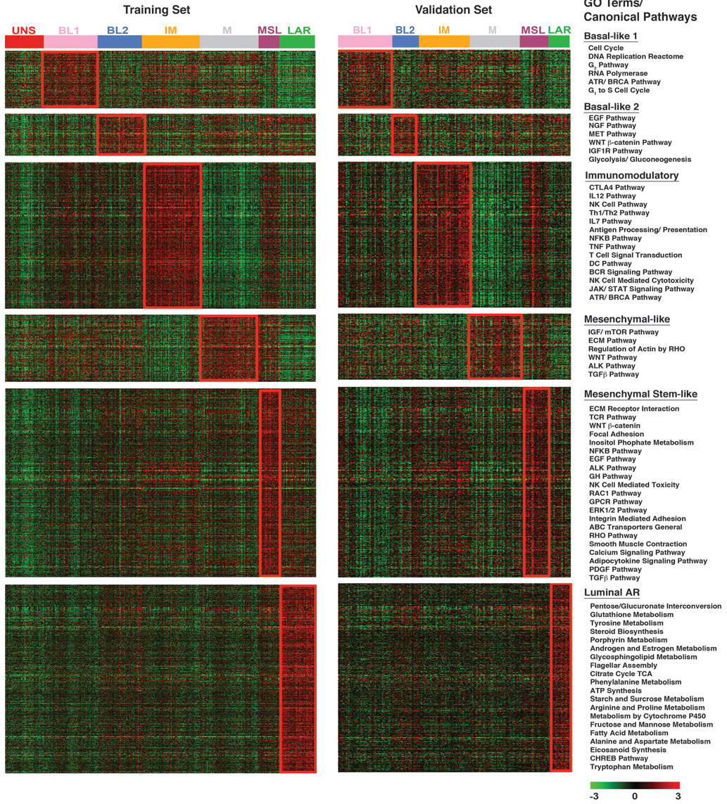
Different Targets for Biological Clusters
BL1: DNA Damage Repair
BL2: MET
IM: Immunmodulatory
Mesenchymal:
Alk, Src, PI3Ki
Luminal Androgen Receptor:
Anti-androgen
Lehmann BD, et al. J Clin Invest. 2011;121(7):2750-2767.

Slide 36
Utilizing Synthetic Lethality Strategies DNA Damage Repair – BRCA & PARP

Slide 37
Utilizing Synthetic Lethality Strategies DNA Damage Repair – BRCA & PARP
DNA
Damage
Single
Strand
Repair

Slide 38
Utilizing Synthetic Lethality Strategies DNA Damage Repair – BRCA & PARP
DNA
Damage
Single
Strand
Repair

Slide 39
Utilizing Synthetic Lethality Strategies DNA Damage Repair – BRCA & PARP
DNA
Damage
Single
Strand
Repair
Double
Strand
Repair

Slide 40
Utilizing Synthetic Lethality Strategies DNA Damage Repair – BRCA & PARP
DNA
Damage
Single
Strand
Repair
PARP
BRCA
Double
Strand
Repair
Cell death

Slide 41
Utilizing Synthetic Lethality Strategies DNA Damage Repair – BRCA & PARP
Why is the effect tumour selective?
Why don’t all patients respond?
DNA
Damage
Single
Strand
Repair
PARP
BRCA
Double
Strand
Repair
Cell death

Slide 42
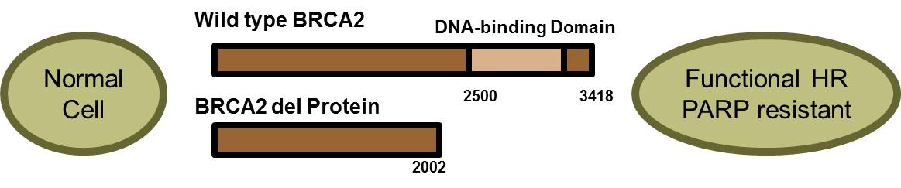
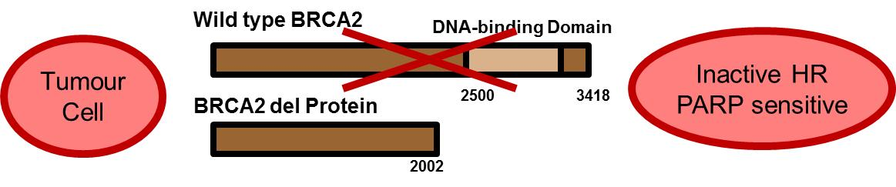
Utilizing Synthetic Lethality Strategies DNA Damage Repair – BRCA & PARP
Why is the effect tumour selective?
Why don’t all patients respond?
DNA
Damage
Single
Strand
Repair
PARP
BRCA
Double
Strand
Repair
Cell death

Slide 43
Utilizing Synthetic Lethality Strategies DNA Damage Repair – BRCA & PARP
Why is the effect tumour selective?
Critical to understand biology
(Epi) genetic background (eg, total vs partial loss of function)
Phenotype (not always lethal but eg, sensitizing)
Alternative options for cells
Why don’t all patients respond?
DNA
Damage
Single
Strand
Repair
PARP
BRCA
Double
Strand
Repair
Cell death

Slide 44
New Targets for TNBC Targeting Immune-Checkpoints (PD-L1)
Tumor-Cell
T-Cell
TCR
+
Activated
+
Inactivated
-
PD-L1
PD-1

Slide 45
New Targets for TNBC Targeting Immune-Checkpoints (PD-L1)
Tumor-Cell
T-Cell
TCR
+
Activated
+
Inactivated
PD-L1
PD-1

Slide 46
New Targets for TNBC Targeting Immune-Checkpoints (PD-L1)
Tumor-Cell
T-Cell
TCR
+
Activated
+
Inactivated
Activated
PD-L1
PD-1

Slide 47
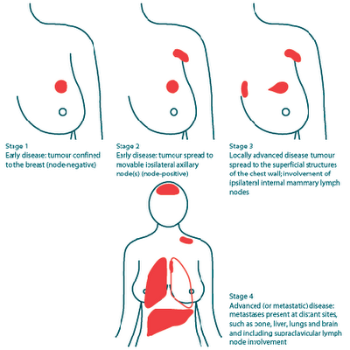

Novel Targeted Therapies and Patient Selection Change of Tumor Biology Over Time
Access to representative tissue critical
Early Breast Cancer
Metastatic disease
Limited access to tissue
Months to years
Tissue
Tissue
Change in tumor biology

Slide 48
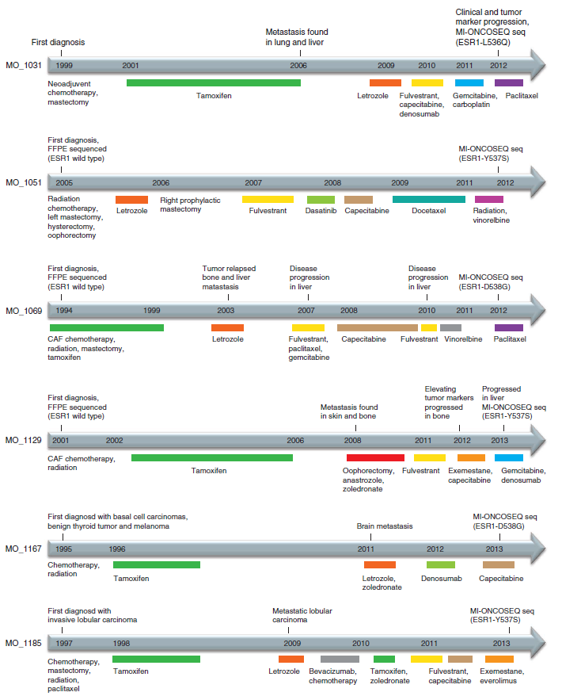
Change of Tumor Biology Over Time Acquired ESR1 Mutations
Primary Tumor
Metastatic disease
ESR1 <1%
ESR1 10-20%?
Robinson DR, Nat Genet. 2013;45(12):1446-1451.

Slide 49
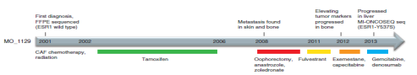
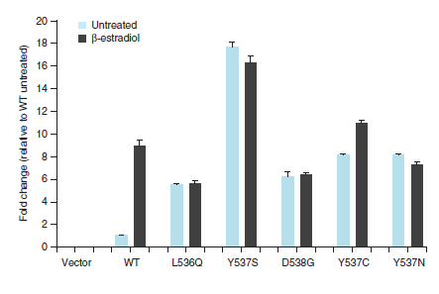
Change of Tumor Biology Over Time Acquired ESR1 Mutations
ESR1-Mutations result in constitutively activated ER
Primary Tumor
Metastatic disease
ESR1 <1%
ESR1 10-20%?
Robinson DR, Nat Genet. 2013;45(12):1446-1451.

Slide 50
Circulating Biomarkers to Assess Dynamic Changes Genetic Profiles From cfDNA
Early breast cancer
Metastatic disease

Slide 51
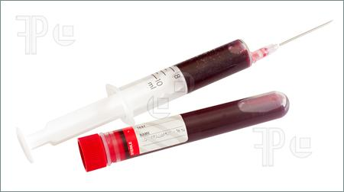
Circulating Biomarkers to Assess Dynamic Changes Genetic Profiles From cfDNA
Early breast cancer
Metastatic disease
(Epi)genetic changes detectable in blood
Simple means for assessing changes

Slide 52
Circulating Biomarkers to Assess Dynamic Changes Genetic Profiles From cfDNA
Longitudinal studies of circulating biomarkers to study plasticity of MBC (eg CirculER)
Early breast cancer
Metastatic disease
(Epi)genetic changes detectable in blood
Simple means for assessing changes

Slide 53
Molecular Targeted Approaches to Therapy in MBC
Summary and Conclusions
ER and HER2 remain the dominant pathways in MBC
Crosstalk between ER or HER2 and signaling pathways is a key driver of endocrine resistance
Combination treatment strategies (eg, with PI3K/mTOR pathway inhibitors or CDK4/6 inhibitors) can overcome resistance
Increasing understanding of the heterogeneity of TNBC reveals new therapeutic targets (eg, DNA Damage repair, Immune checkpoints)
Lack of biomarkers for patient selection remains challenging

